Slide 1
Movie Industry Trends
Data by IMDB
Slides by Ryan Healy

Slide 2
Objective
Executive Summary
After a series of Box Office flops we have an urgent need to better understand our industry
Graphics and analysis were done using Python with code and run instructions available here
Franchises aren’t immune - they have falling profit as well
People like TV shows more than movies on IMDB
Bet on Directors - lightning can strike twice
Tears and Laughs - Drama and Comedy play well with the international market
War Never Changes - War and History are on average well reviewed and profitable (especially in the US and UK)

Slide 3
AGENDA
01
BACKGROUND
04
Action Plan
The Data
Market Trends
Conclusion
Appendix
02
What Goes into a 5x movie
Summary
Bet on Directors
03
Exploring Genres
Overall
works in the US
Works outside the US

Slide 4
Issues
IMDB doesn’t just rank Movies but also TV shows
No primary_key had to make one to uniquely identify data, there was unnecessary duplicates
No clarity on why some data was missing, need to investigate data pipeline
Potential Sampling Bias as people fondly remember movies prior to Digital Age
Data to segment streaming, hard to understand changing consumer behaviors otherwise
Invest in Data Model could include sources of variation like Demographics, Economic data, and Online Behaviour Which could be controlled for with some more investment.
Explore New Technology New and Improved Gen AI offer great Text Generation which could infer Genres not thought of before (Netflix Famous for this) - would require investment
Opportunities
Data
01
Using a sample of 4,804 movies or about 1% of the total Movies on IMDB (source) from between 1916 and 2016 - IMDB Stats here

Slide 5
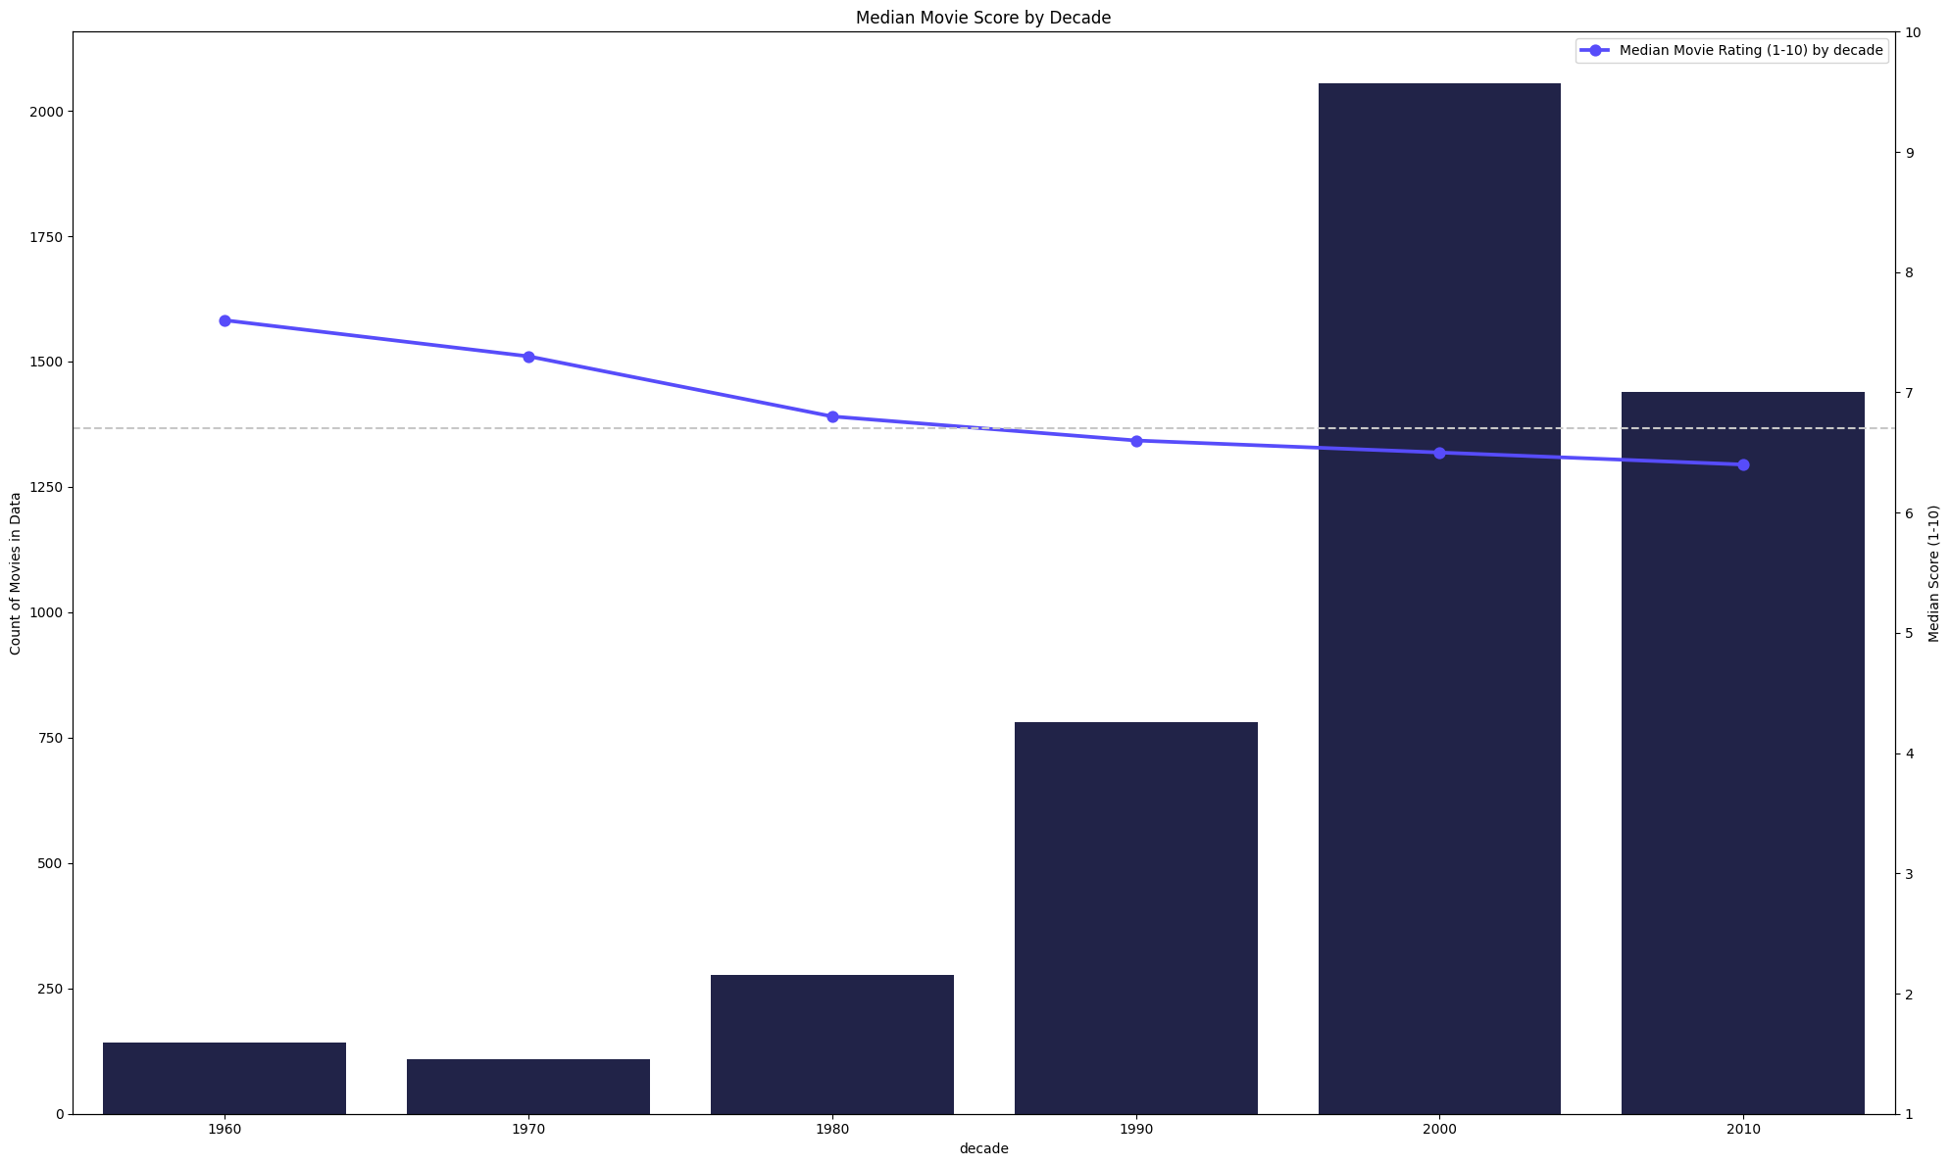
Market Trend - Median Ratings Down
01
There has never been as many movies, but doesn’t mean people are Happy
eraerad
The Median Movie Score as rated by the Audience is falling and has been for some time
The Digital Age has has seen an explosion of movies being made and reviewed

Slide 6
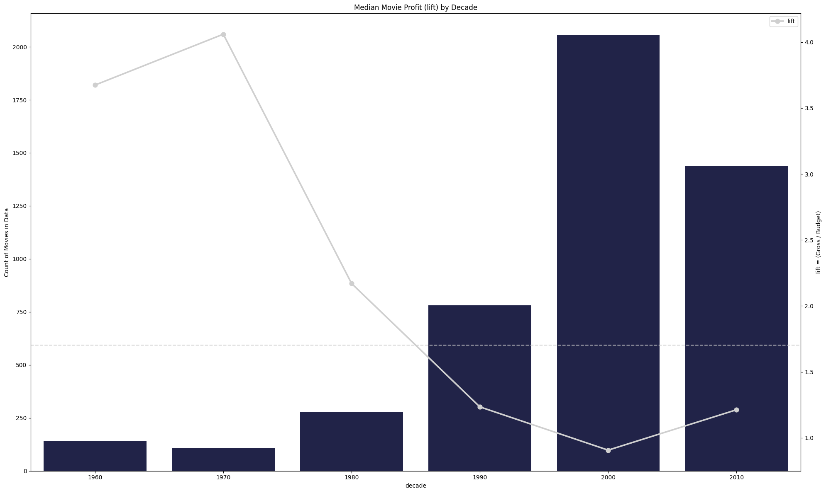
Market Trend - Falling Returns
01
As more Movies are getting made their returns are also Falling
Profitability has also been falling. Across the board its a tough industry for everyone as money tries to find a return
* Ideally want a Lift Ratio of about 2-3x as that would recoup Marketing and Promotional losses.

Slide 7
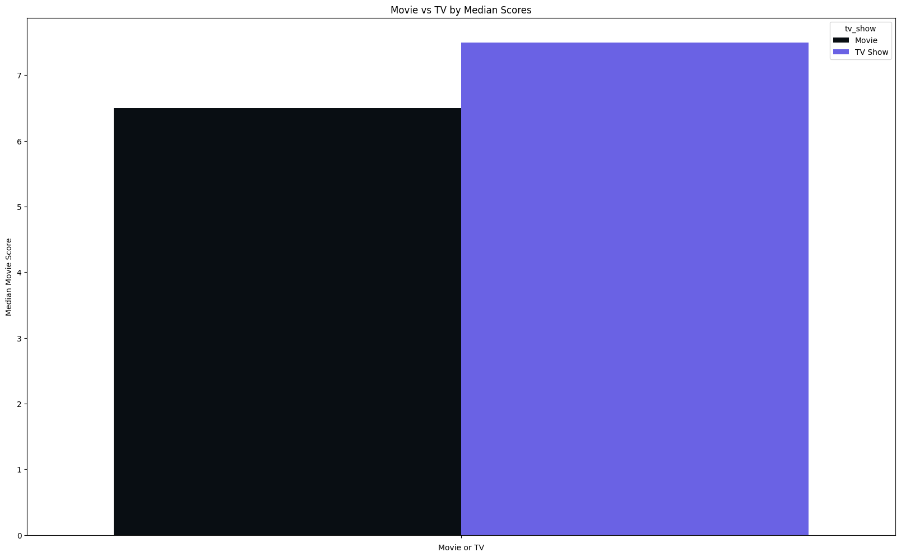
Market Trend - TV vs Movies
01
More people are rating the TV shows higher
TV Shows have a higher median rating
Limited data on TV shows but it’s clear people are really down on Movies

Slide 8
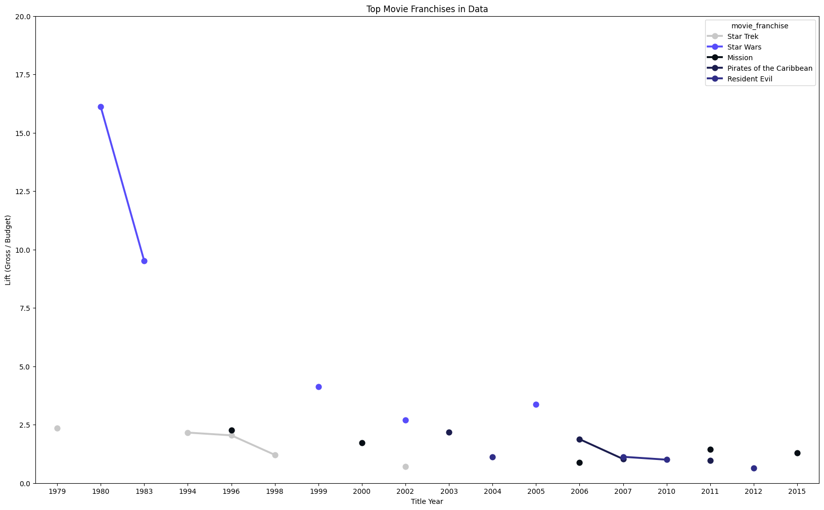
Market Trend - Falling Returns - Franchises
01
Even across well known franchises movies are getting less profitable
Profitability has also been falling even in the Top Franchises.
They are just getting so expensive to build they are getting under the ROI range where the investment pays out

Slide 9
What goes into a Hit Movie
02
What characterises a (5x) Movie?
Is a Breakout Hit (5x) | yes | no
Count (n) | 358 | 4,446
Median movie score | 7 | 6
avg users voted | 76,835 | 31,273
Median facebook likes | 2,442 | 3,173
Median director likes | 113 | 79
Median actor1 likes | 893 | 1,000
Median actor2 likes | 504 | 616
Median actor3 likes | 300 | 385
Median duration | 102 | 104
Median title year | 1,998 | 2,006
Number of users voted | 53,494,078 | 349,599,327
Median gross | $50,960,470 | $22,726,122
median_budget | $5,000,000 | $20,000,000
These hits are about 7% of all movies
Example Breakout movies are The Lion King, Garden State, Jackass: The Movie, Boyz n the Hood
Characterized by
higher movie scores
an exponential number of users voting online for them,
higher Director Facebook likes (despite being on average before facebook)

Slide 10
What goes into a Hit Movie
02
Exploring the Directors a big
Higher percent of directors in the breakout group have been there twice
The lift is higher and if they’ve been there they can again just not always with the same Franchise
Think
Ang Lee
Alfred Hitchcock
Steven Spielberg
Is it a Breakout Hit? (5x) | no | yes
Count (n) | 4,446 | 358
Director more than twice | 3,013 | 273
Average Directing Year | 2,003 | 1,994
Median Lift | 0.94 | 8.80
(%) of Directors more than Twice | 67.77% | 76.26%
The difference between the proportion of Directors having a hit twice is Statistically Significant * see notebook

Slide 11
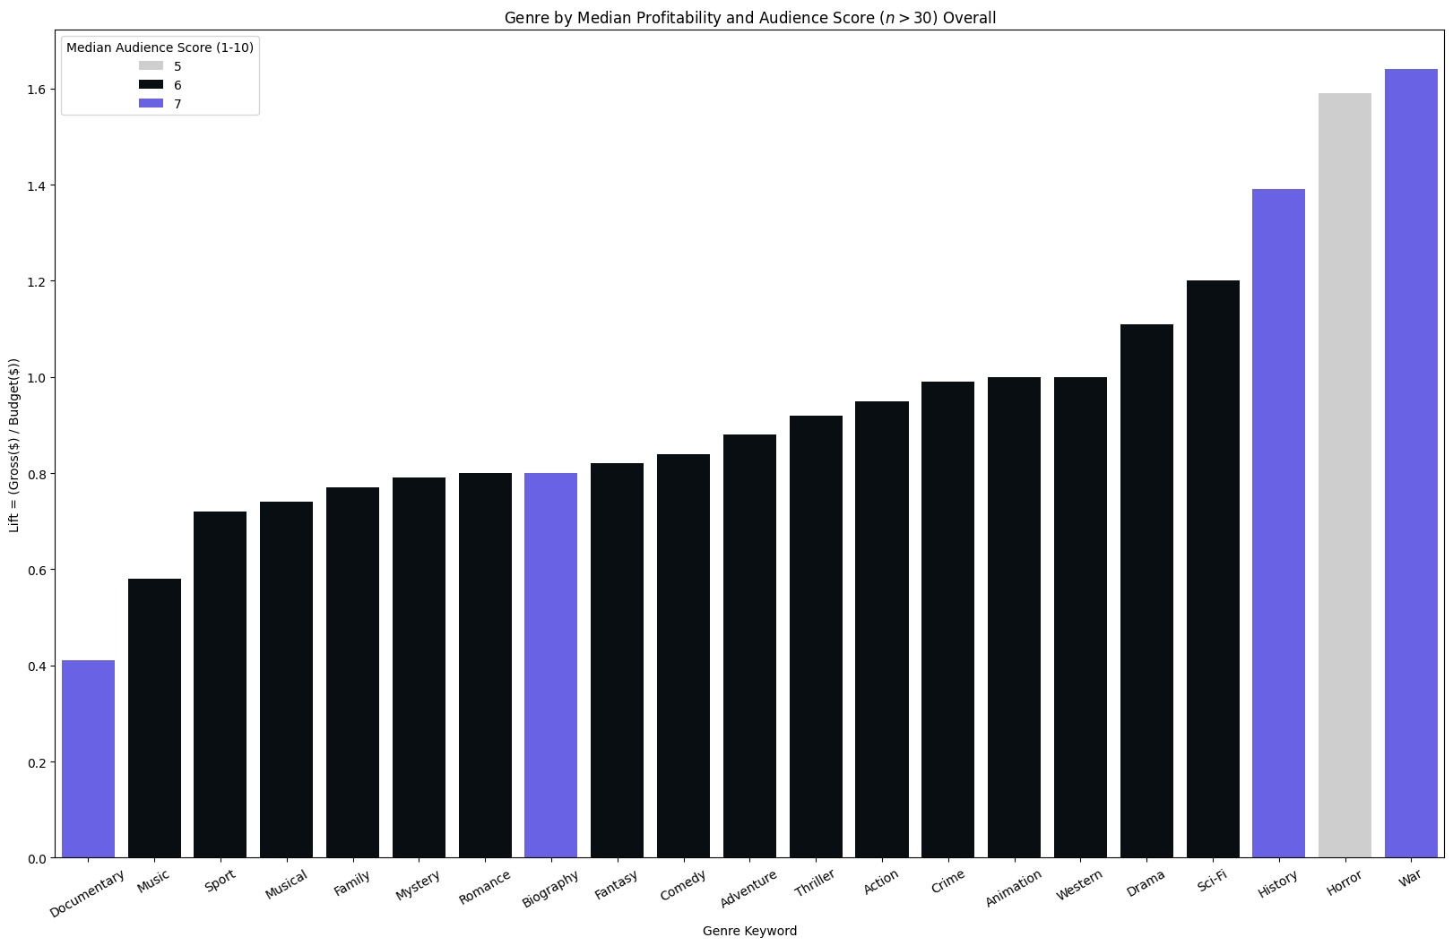
Exploring Genres - Overall
03
Not all Genres are created Equal
No genre gives an expectation of profit or rave reviews but some have a higher expected value.
Overall War and History Movies seem to be at the intersection of highly rated and profitable
There is considerable Variability in Genres in both Profitability and Audience Reviews.

Slide 12
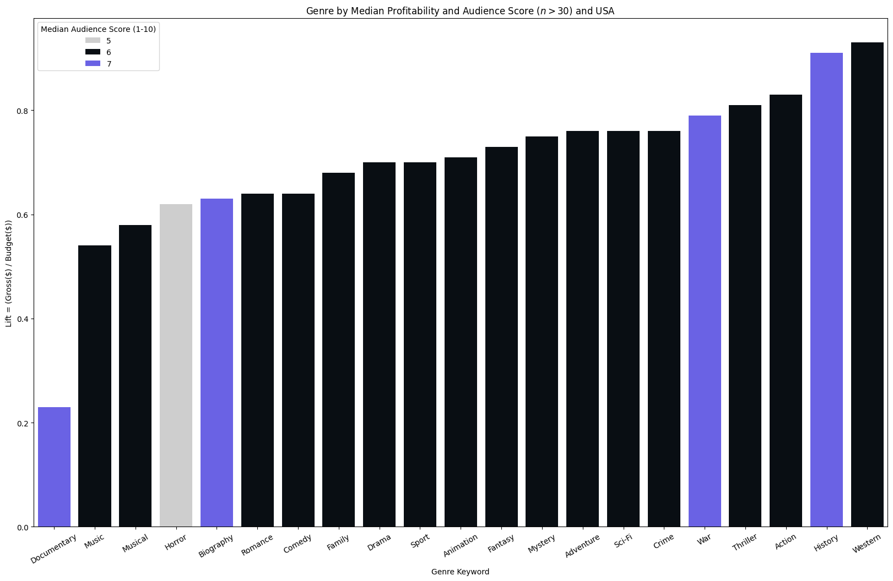
Exploring Genres - USA Only
03
Not all Genres are created Equal
No genre gives an expectation of profit or rave reviews but some have a higher expected value.
Expected Profit is even lower in the US than in other places
Continue to see War and History trends

Slide 13
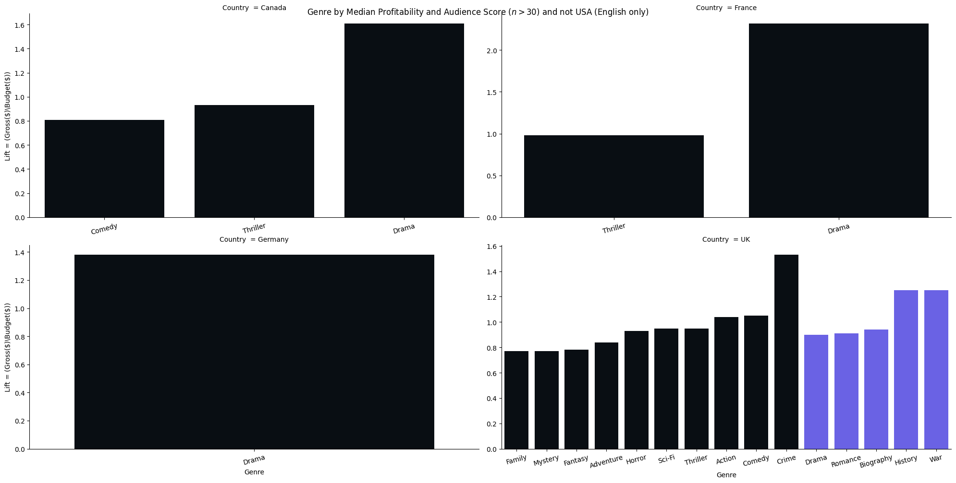
Exploring Genres - Non US - English only
03
Not all Genres are created Equal
Dramas play well in Canada, France, and Germany
In the UK Crime, History, and War all play well

Slide 14
Conclusions
04
Franchises aren’t immune - they have falling profit as well
People like TV shows more than movies on IMDB
Bet on Directors - lightning can strike twice
Tears and Laughs - Drama and Comedy play well with the international market
War Never Changes - War and History are on average well reviewed and profitable (especially in the US and UK)
Need to act now! More research is also needed
Data to segment streaming, hard to understand changing consumer behaviors otherwise
Invest in Data Model could include sources of variation like Demographics, Economic data, and Online Behaviour Which could be controlled for with some more investment.
Explore New Technology New and Improved Gen AI offer great Text Generation which could infer Genres not thought of before (Netflix Famous for this) - would require investment

Slide 15
Questions?

Slide 16
Appendix

Slide 17
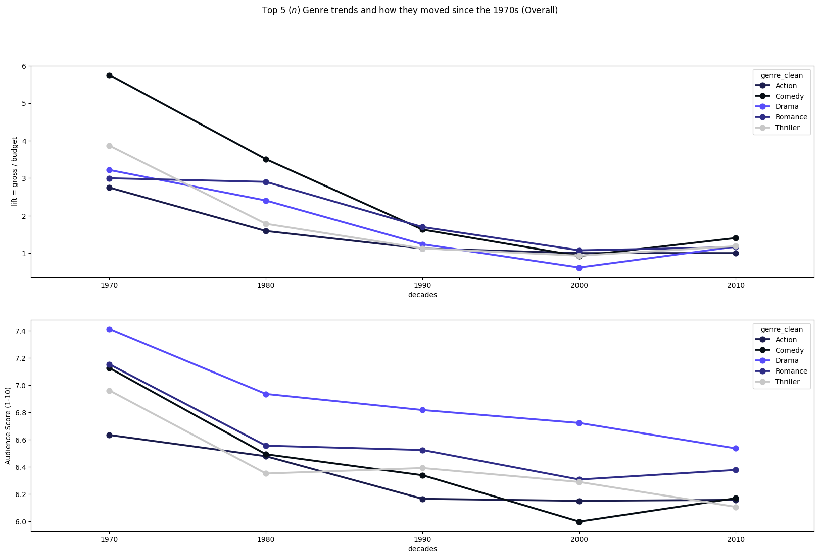

Slide 18
